Slide 1

SCS1301 - OPERATING SYSTEM
UNIT – 1
INTRODUCTION TO OS
Dr. P. Sardar Maran
Associate Professor
DEPARTMENT OF CSE
SCHOOL OF COMPUTING

Slide 2
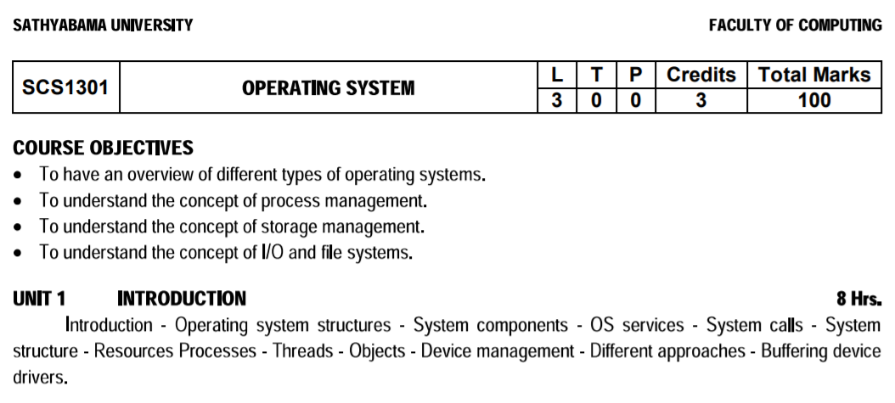
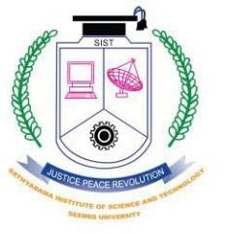

Slide 3
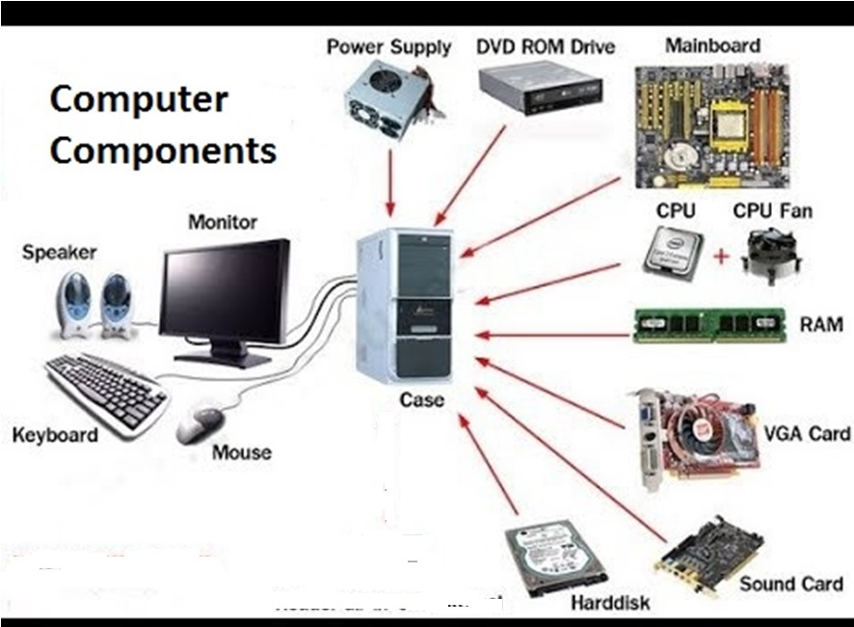

Slide 4
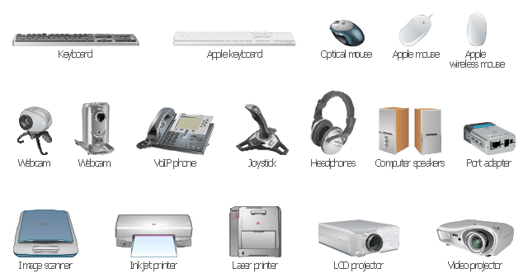
Peripheral for computers

Slide 5
History of Operating System
Operating systems were first developed in the late 1950s to manage tape storage
The General Motors Research Lab implemented the first OS in the early 1950s for their IBM 701
In the mid-1960s, operating systems started to use disks
In the late 1960s, the first version of the Unix OS was developed
The first OS built by Microsoft was DOS. It was built in 1981 by purchasing the 86-DOS software from a Seattle company
The present-day popular OS Windows first came to existence in 1985 when a GUI was created and paired with MS-DOS.

Slide 6
INTRODUCTION
First Operating System
Microsoft Disk Operating System, MS-DOS
Short for Microsoft Disk Operating System, MS-DOS is a non-graphical command line operating system created for IBM compatible computers.
MS-DOS was first introduced by Microsoft in August 1981 and was last updated in 1994 with MS-DOS 6.3. Although the MS-DOS operating system is rarely used today, the command shell commonly known as the Windows command line is still widely used
To open the "cmd", click on the searching cmd.

Slide 7
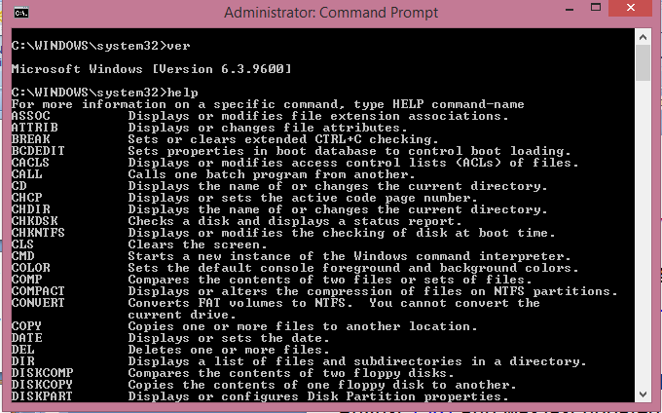
MS-Dos

Slide 8
UNIX Operating System
Unix was originally developed in 1969 by a group of AT&T employees Ken Thompson, Dennis Ritchie, at Bell Labs.
The original spelling was “UNICS” (UNiplexed Information and Computing Service)
There are various Unix variants available in the market. Solaris Unix, AIX, HP Unix and BSD are a few examples.
Several people can use a Unix computer at the same time; hence Unix is called a multiuser system.
A user can also run multiple programs at the same time; hence Unix is a multitasking environment.

Slide 9
Linux Operating System
Linux is the most popular server OS. Linux is a clone of UNIX.
Some of the most popular distributions are Ubuntu, Red Hat Enterprise Linux (RHEL), Debian, Fedora, CentOS, OpenSuSE, Arch, Mint, and Solus.
Linux is as an idea in the mind of young and bright Linus Torvalds when he was a computer science student. He used to work on the UNIX OS (proprietary software) and thought that it needed improvements.

Slide 10
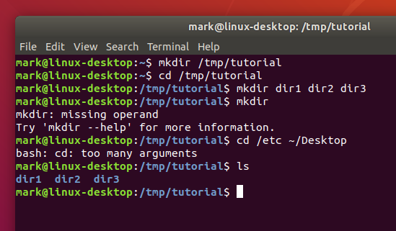
Ubuntu- Linux screen

Slide 11
macOS
macOS (previously called OS X) is a line of operating systems created by Apple. It comes preloaded on all Macintosh computers, or Macs. Some of the specific versions include Mojave (released in 2018), High Sierra (2017), and Sierra (2016).
macOS users account for less than 10% of global operating systems—much lower than the percentage of Windows users (more than 80%). One reason for this is that Apple computers tend to be more expensive. However, many people do prefer the look and feel of macOS over Windows.

Slide 12
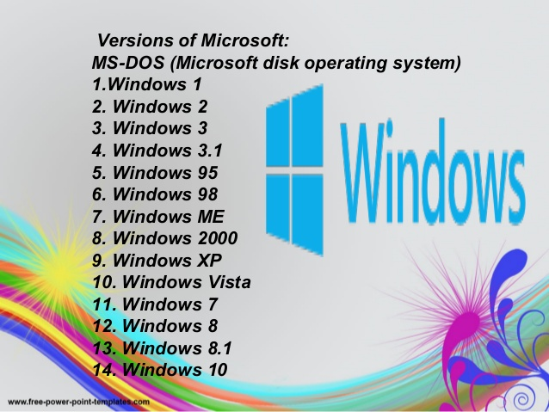
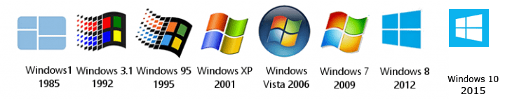

Slide 13
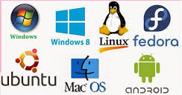
Various Operating Systems

Slide 14
Linux vs Windows
Linux is an open source operating system whereas Windows OS is a commercial operating system so user doesn’t have access to source code.
Linux is very well secure as it is easy to detect bugs and fix whereas Windows has a huge user base, so it becomes a target of hackers to attack windows system.
Linux runs faster even with older hardware whereas windows are slower compared to Linux.
Linux peripherals like hard drives, CD-ROMs, printers are considered files whereas Windows, hard drives, CD-ROMs, printers are considered as devices
Linux files are ordered in a tree structure starting with the root directory whereas in Windows, files are stored in folders on different data drives like C: D: E:
In Linux you can have 2 files with the same name in the same directory while in Windows, you cannot have 2 files with the same name in the same folder.
In Linux you would find the system and program files in different directories whereas in Windows, system and program files are usually saved in C: drive.

Slide 15
WHAT IS OPERATING SYSTEM?
An Operating System (OS) is an interface between a computer user and computer hardware.
An operating system is a software which performs all the basic tasks like file management, memory management, process management, handling input and output, and controlling peripheral devices such as disk drives and printers.

Slide 16
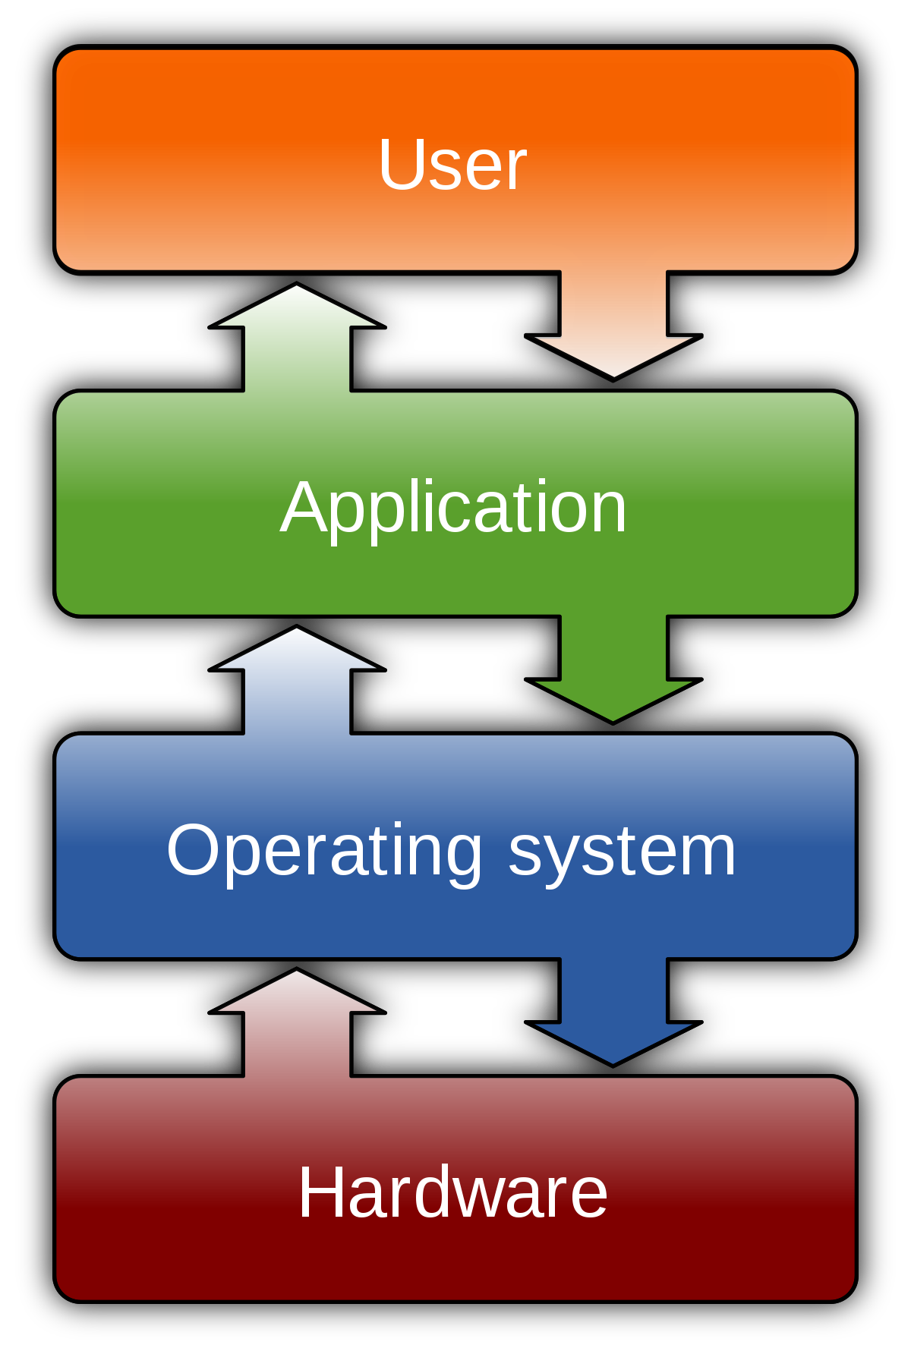
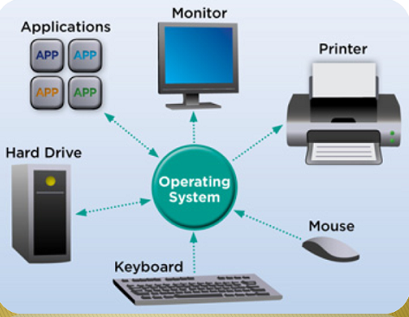
WHAT IS OPERATING SYSTEM

Slide 17
Features of Operating System
Here is a list commonly found important features of an Operating System:
Protected and supervisor mode
Allows disk access and file systems Device drivers Networking Security
Program Execution
Memory management Virtual Memory Multitasking
Handling I/O operations
Manipulation of the file system
Error Detection and handling
Resource allocation
Information and Resource Protection

Slide 18
Basic Software Bundles (after installing windows)
Microsoft Office (MS Word, Excel, Power point, Acess etc)
Adobe (PDF)
WinZIP, WinRAR
VLC media Player
Antivirus (Kaspersky, Mcafee, Avast,AVG)

Slide 19
Operating System Services
An OS provides environment for the execution of programs.
It provides certain services to programs and to the users of those programs.
These OS services are provided for the convenience of the programmer, to make the programming task easier. One set of operating-system services provides functions that are helpful to the user are,
PROGRAM EXECUTION
I/O OPERATIONS
FILE-SYSTEM MANIPULATION
COMMUNICATIONS
ERROR DETECTION
RESOURCE ALLOCATION
PROTECTION AND SECURITY

Slide 20
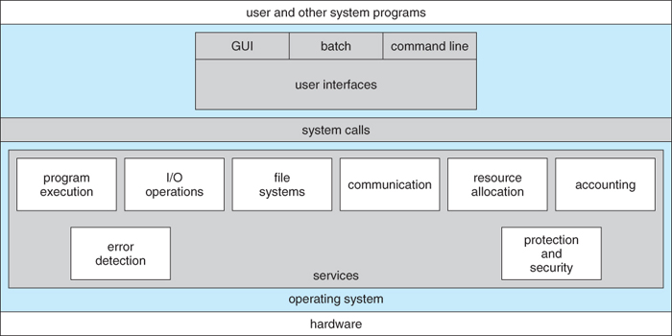
OS Services

Slide 21
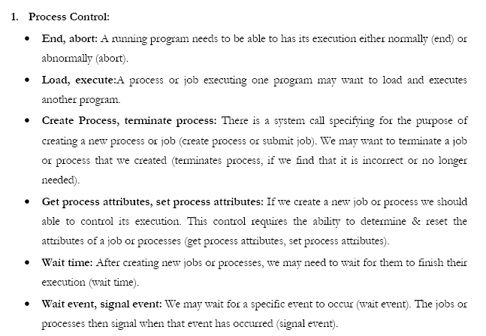
Program Execution

Slide 22
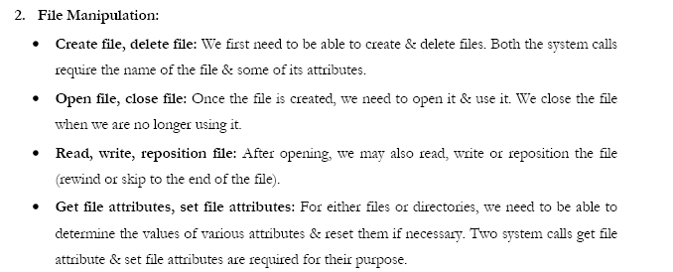
File Manipulation

Slide 23
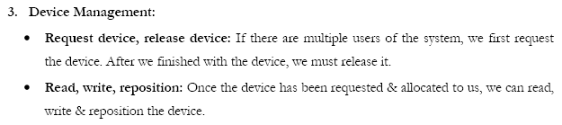
Device Management

Slide 24
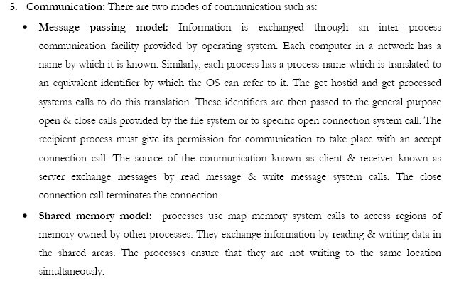
Communication

Slide 25
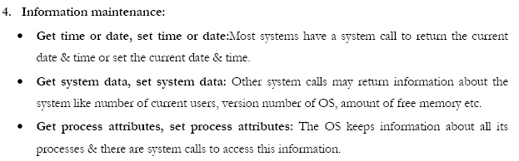
Information Maintenance

Slide 26
Questions?
Put your Questions in Chat box

